Slide 1

Data Science Weather
Shahar Baba
Gal Bachar

Slide 2
Topics
Data Acquisition
Data Cleaning
EDA
Machine Learning

Slide 3
Data acquisition
We crawled weather data since 1950 until today. The data for each day contains date, temperature, dew point, wind speed etc.
we Stored THE relevant data FOR Each day in data frame, Each row is a specific day.
crawling has done using selenium.

Slide 4
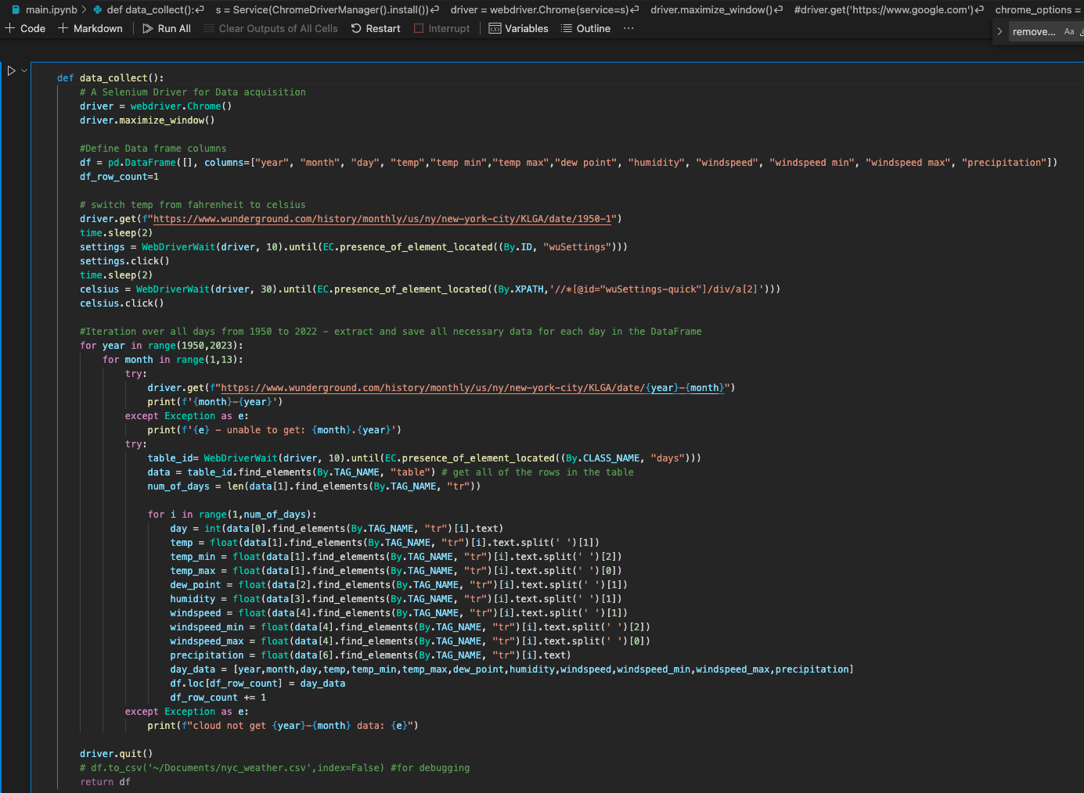
Crawled and stored the data in data frame

Slide 5


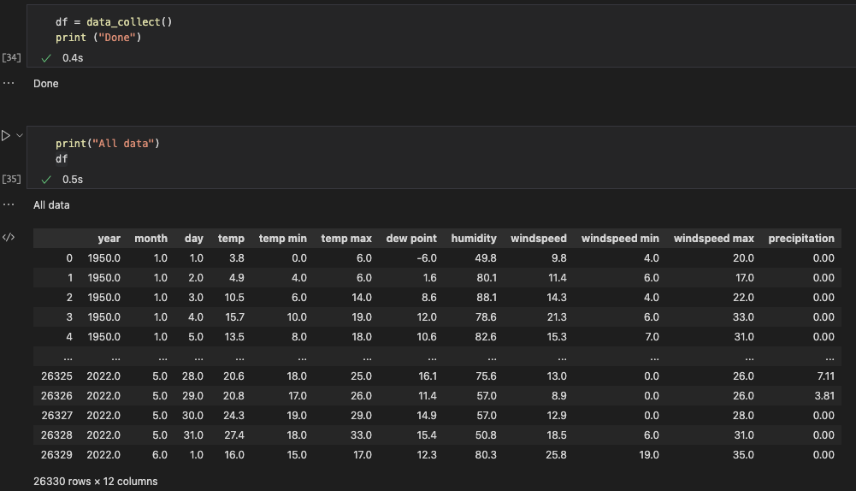
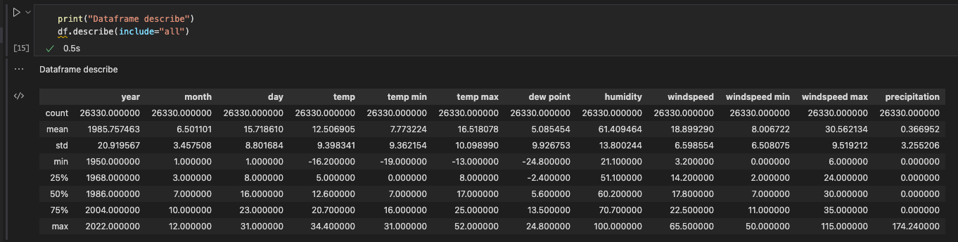

Slide 6

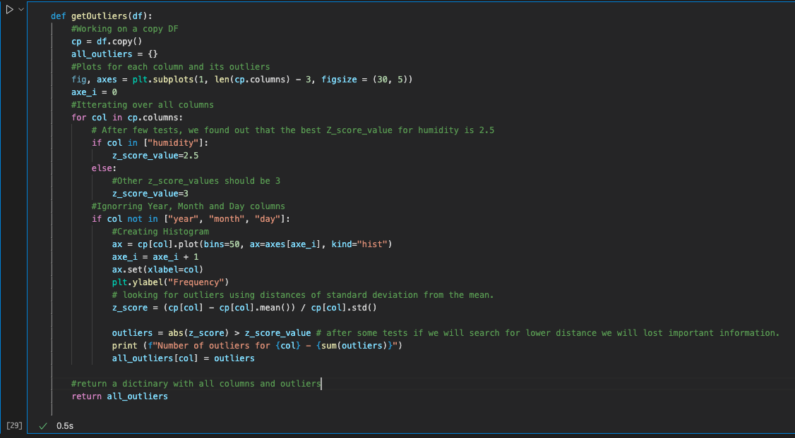
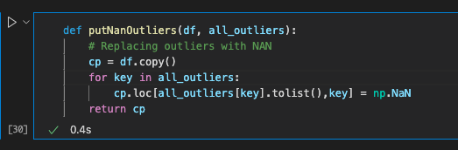
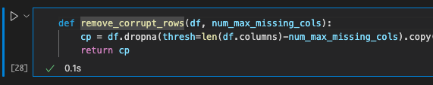
Data Handling Cleaning & normalize

Slide 7
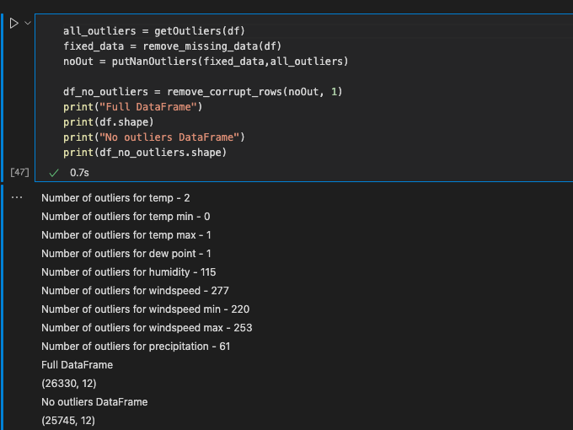
Data Cleaning Output

Slide 8
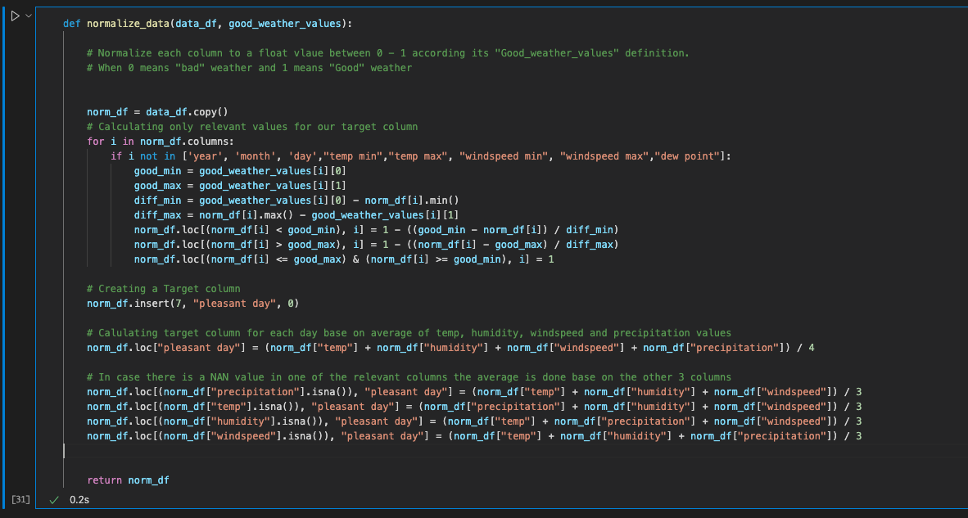
Normalize data

Slide 9
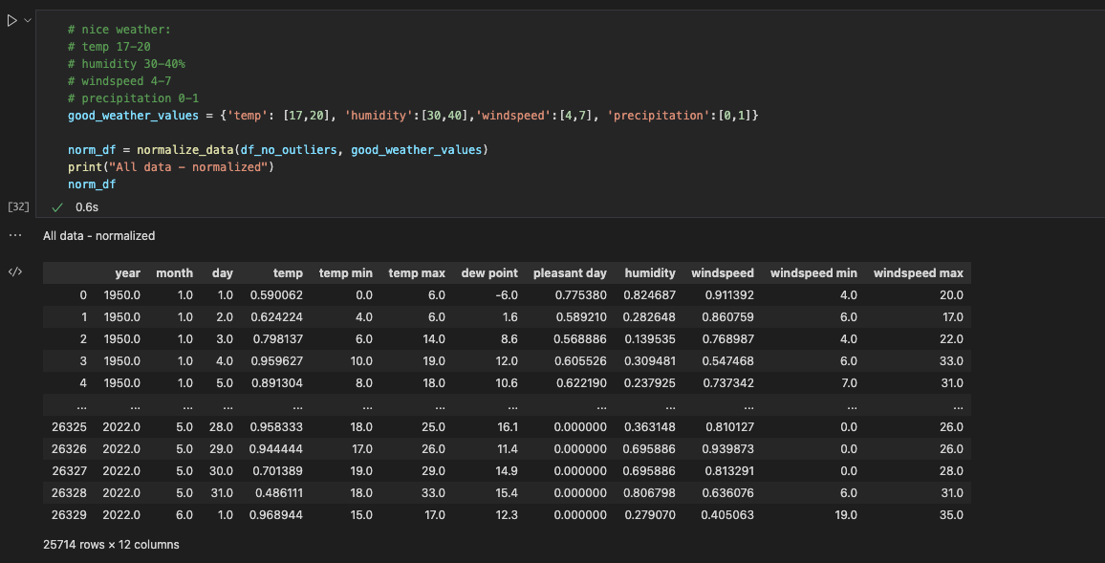
Normalize data

Slide 10
Exploratory Data Analysis
Outliers Histogram
Only Outliers data
All data with outliers
over the time chart
Temperature
Humidity
Windspeed
Number of good days divided to months
Pie chart
Line graph
Pleasant day mean per month (line chart)
All time “pleasant day” values
Highly correlated columns
Temp – pleasant day
windspeed – pleasant day

Slide 11
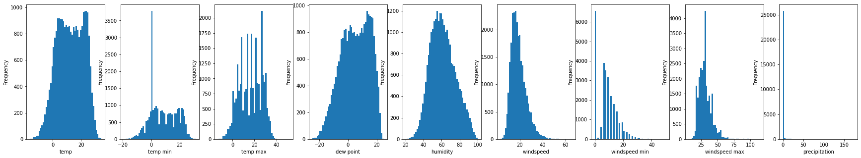
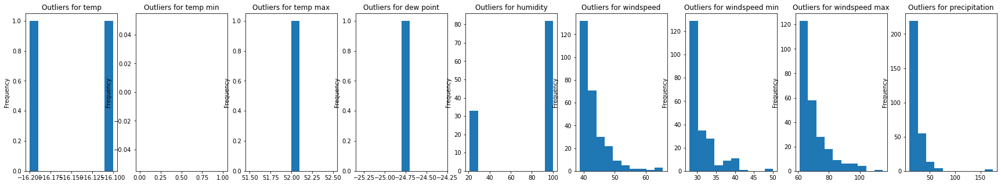
Outlier’s histograms

Slide 12
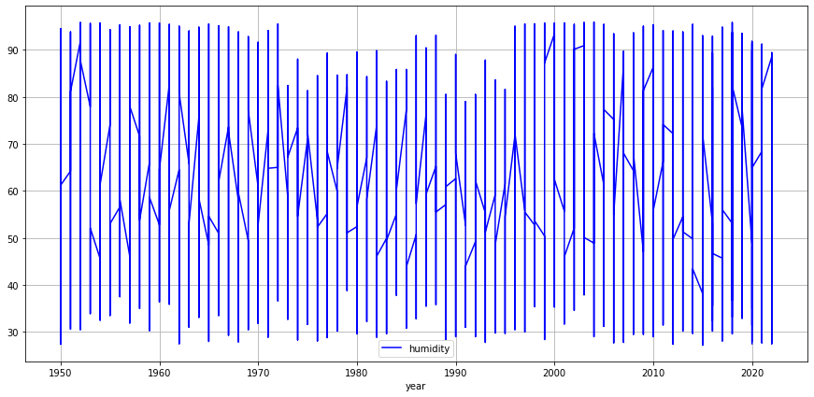
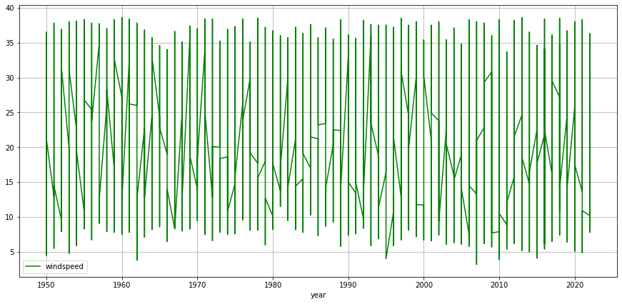
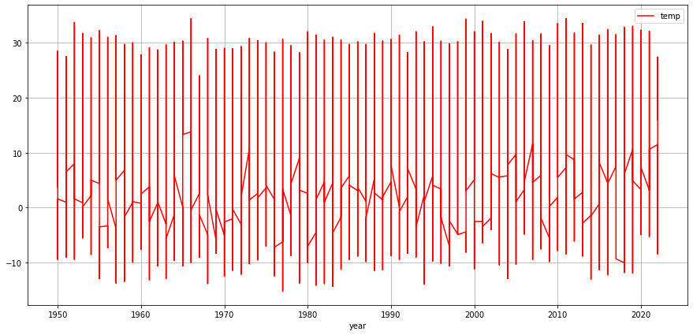
Over time chart

Slide 13
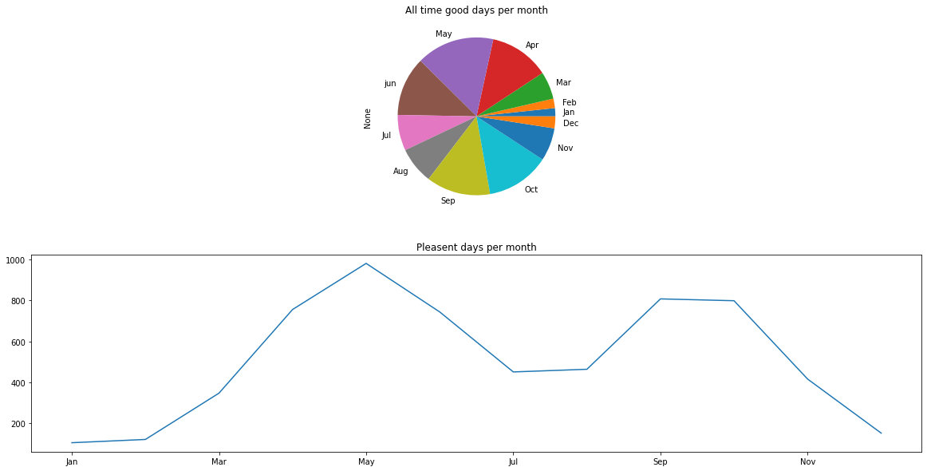
Number of good days per months
* Pleasant day = day with calculated score >= 0.75

Slide 14
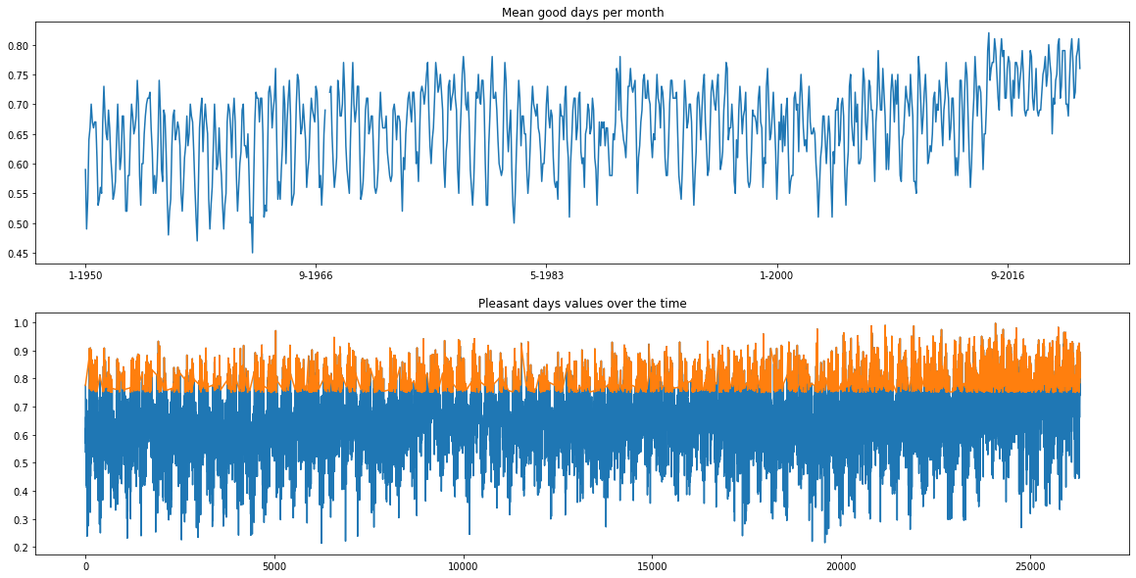

Slide 15
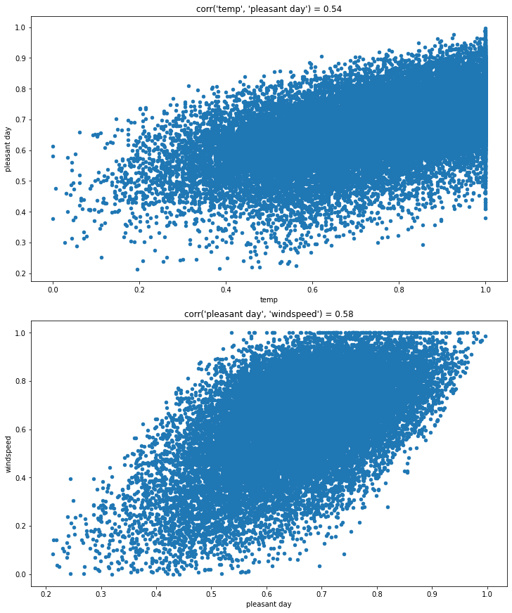
Highly correlated columns

Slide 16
Machine Learning
Research question
Can we predict if the next day going to be a pleasant day, using historical data ?
Our model
In our project we have collected data over the years for each day and calculated the weather rating each day (“pleasant day” value between 0 to 1)
In order to predict the future values of a specific day we had to use “Linear regression” model

Slide 17
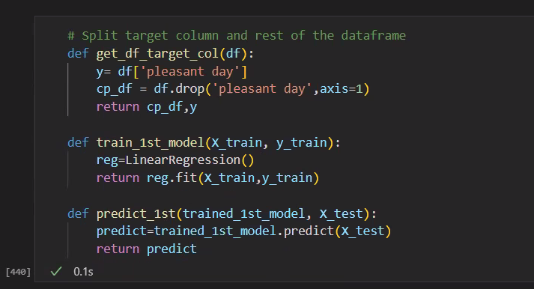
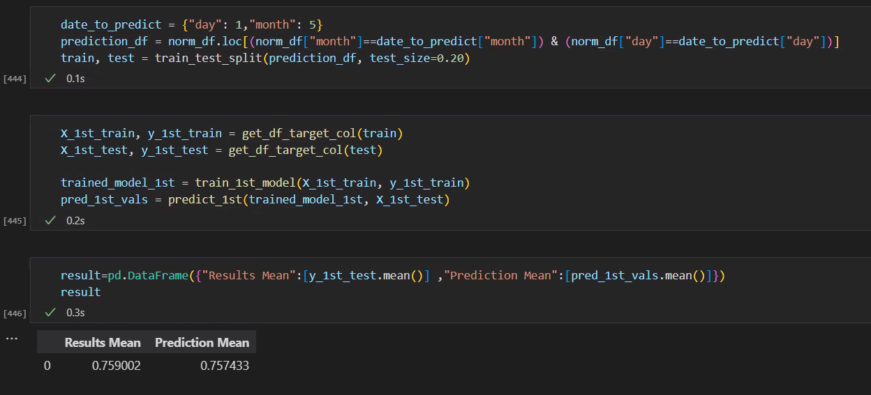

Slide 18
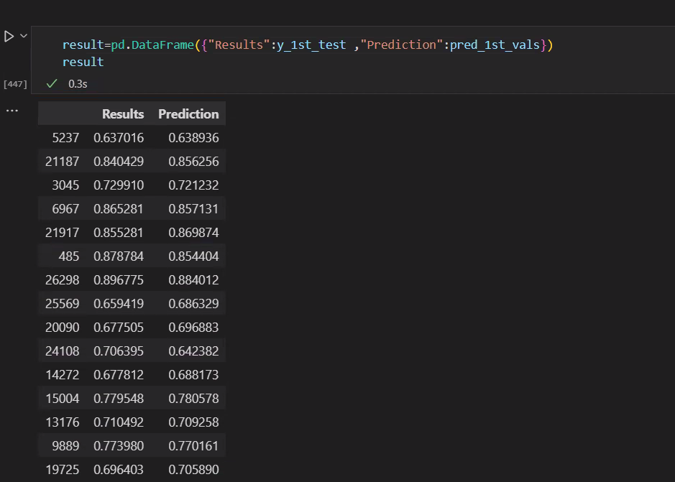

Slide 19
Thank You

